Slide 1
NIEM MO Community Tools Update IEPD Tooling
Mr. Lanzo Wallace
Joint Staff J6, DDC5I, Data & Services
757-836-8090
Lanzo.wallace.civ@mail.mil

Slide 2
Agenda
Voice of the customer
Discuss Tool requirements
Review COA`s
Questions

Slide 3
Voice of the Customer
Automation
Easy to use
Open source & user-installable.
Accreditation in appropriate environments to facilitate tool creation .
Modular to support incremental improvements.
Support a self-service model.
Provide capabilities that satisfy the needs of the community and that aren't available from other tools.
User friendly
Third party tool hosting (e.g. Sparx EA, Magic Draw CAMEO plugin and Wayfarer)

Slide 4
Where are we Today?
IEPD Creation
Not user friendly
Does not generate NIEM-conformant JSON (e.g. using Movement)
Does not have a UML model
Existing NIEM community tools
Movement
ConTesA
SSGT
Mapping spreadsheet
General XML/JSON/UML tools
Oxygen
SparxEA
MagicDraw
XMLSpy

Slide 5
IEPD Tool: Requirements
Extensibility
SSGT Web API
Movement Web API
ConTesA Web API
Mapping API
NIEM UML model
NIEM data dictionary
Should be accessible to a non-technical user (e.g., an easy mode tool)
Should be able to generate (XML, JSON, SQL and UML )
Search
Top-down browsing
Open source & user-installable
Generate all IEPD required artifacts
Automate as much as possible

Slide 6
COA: 1
Improve Current environment to provide additional capability
UI improvements:
Improve component display & navigation so you can find context & uses of properties & see and navigate through types.
Allow addition of types and complex elements to the subset
Enable Movement to generate subsets using a web service common to it and the SSGT.
Would allow building NIEM subset schemas directly from the Movement tool.
Would allow Movement and SSGT (and other tools that use the web service) to build XML Schema & JSON Schema, when that functionality is developed
Document Code
Identify the code used to create SSGT, Movement and Contessa
APIs
SSGT Web API
Movement Web API
ConTesA Web API
Mapping API

Slide 7
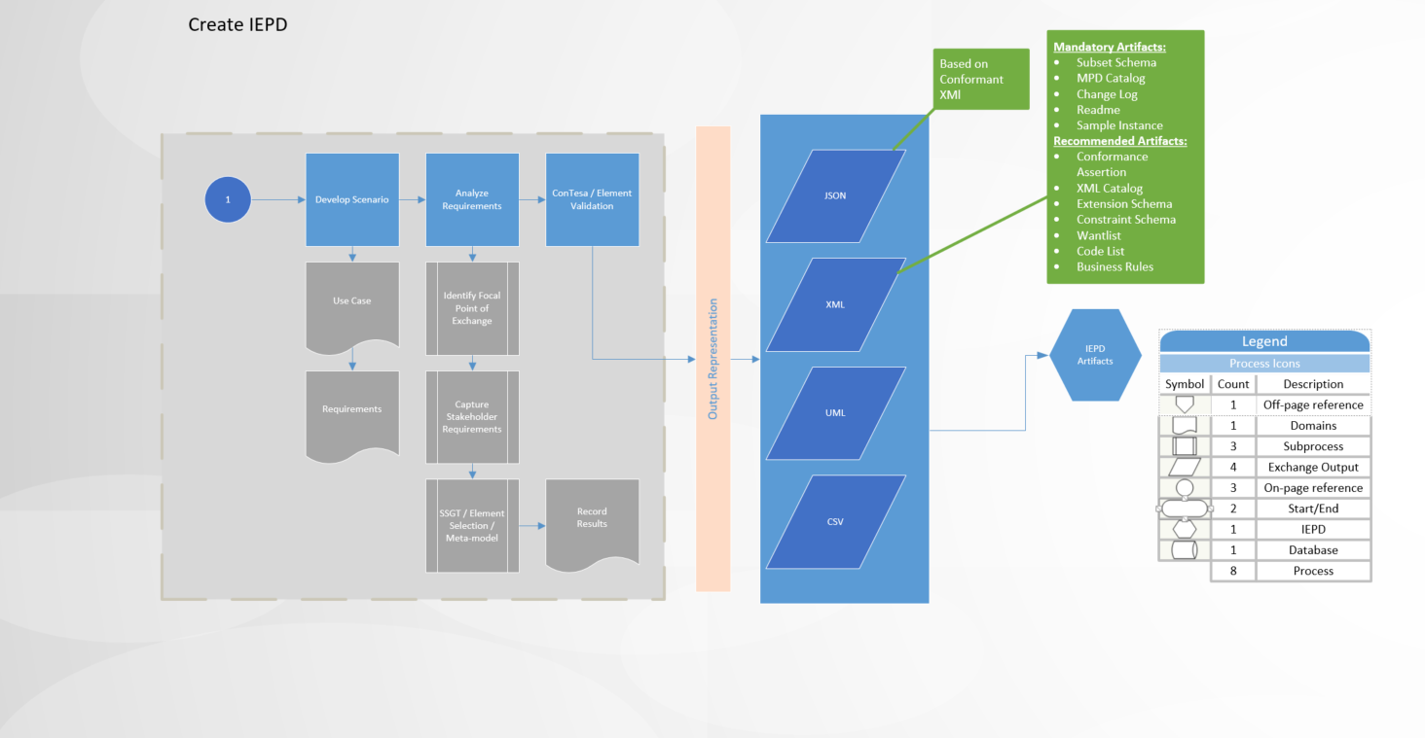
COA:2
Automated (indexed and web-accessible IEPD capability
Represent all data as objects
Metamodeling object generation
Ability to output different data formats

Slide 8
RECOMMENDATION
NTAC approve IEPD Tool COA-1
*******************************************************
NTAC Decision: ___Approve ___Disapprove

Slide 9
Feedback?

